Slide 1
Variant analysis workshop and workflow tutorial
Lindsay Clark, April 25, 2023

Slide 2
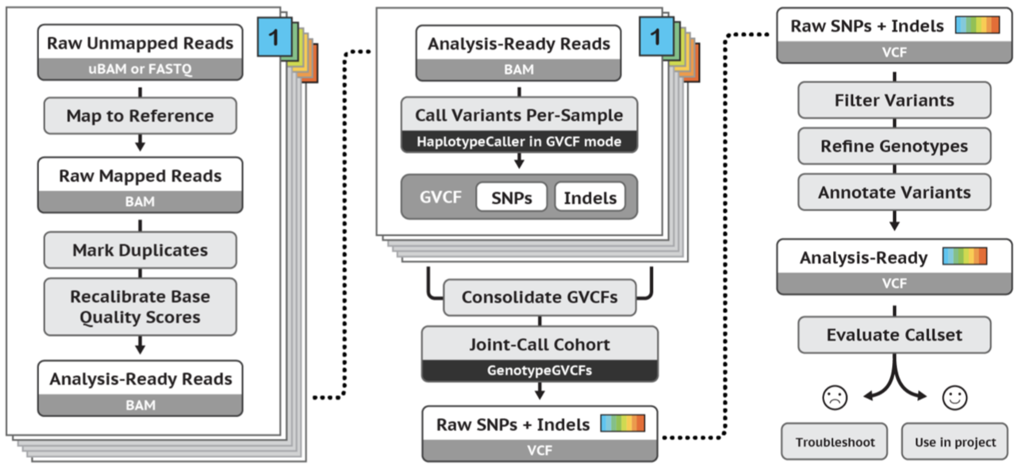
Overview from GATK Best Practices
See https://gatk.broadinstitute.org/hc/en-us/articles/360035535932-Germline-short-variant-discovery-SNPs-Indels-

Slide 3
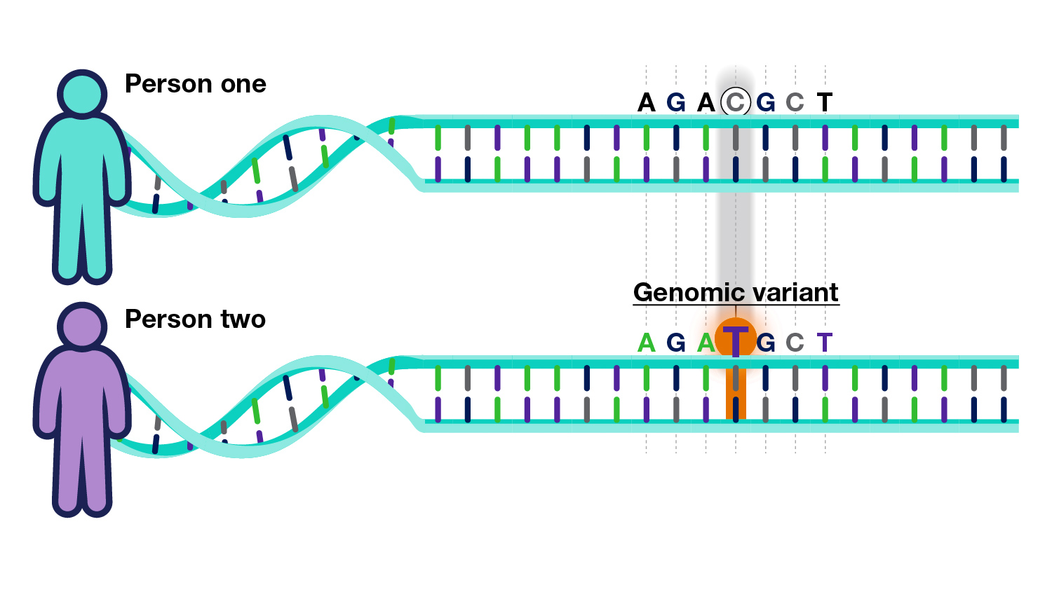
Why do variant analysis
Molecular diagnosis of rare genetic conditions
Tumor-normal comparisons for characterizing cancers
Identify genes and pathways involved in a disorder
Identify pathogenic variants
Image: https://www.genome.gov/Health/Genomics-and-Medicine/Polygenic-risk-scores

Slide 4
Experimental designs and analysis strategies
Affected cases vs. unrelated healthy controls
Genome-wide association studies (GWAS) possible with thousands of individuals, to identify specific variants that are risk factors.
Other stats (e.g. gene level) possible with smaller cohorts.
Parent-offspring trios
Possible to distinguish inherited alleles from de novo mutations
Parent-offspring duos give partial information about inheritance
Larger families
Multiple affected individuals, as well as affected/unaffected sibling pairs, help to narrow down causative variants

Slide 5
Library strategies
Whole genome sequencing (WGS)
Expensive, enormous datasets
Good if you are interested in variants in non-coding DNA
Whole exome sequencing (WES)
Use probe capture to focus sequencing on exonic regions
1% of genome with 85% of disease-causing variants
Cost effective and quicker to process

Slide 6
Sequence alignment
Generates a multi-Gb BAM file for each individual sequenced
Unlike RNA-seq, splice-aware alignment is not necessary
BWA and Bowtie2 are popular aligners
BAMs contain sequence and quality scores from the FASTQ, as well as information about alignment to genome
GATK Best Practices includes marking duplicates and recalibrating base quality scores

Slide 7
Variant calling
Goes through the BAM to distinguish true variants from sequencing error
GATK, DeepVariant, FreeBayes are common software for this.
Sarek is a nf-core pipeline that uses GATK
Output one GVCF per individual.
The GVCF has data on all regions covered by the BAM, including allelic read depths and preliminary genotype calls for that individual
All sites with non-reference alleles, as well as all covered sites that match the reference
The GVCF format varies from software to software, in particular how stretches matching the reference are summarized.

Slide 8
Joint genotype calling
Start with one GVCF per individual, get a VCF with variable sites only, genotyped across the entire cohort.
Observation of a variant across a population increases confidence in call
GATK, GLnexus are software for this

Slide 9
Run call_trios workflow
BAM
GVCF
BAM
GVCF
VCF
BAM
GVCF
This uses DeepTrio (a branch of DeepVariant) to run variant calling, using parent-offspring relationships to help distinguish real variants from sequencing error.
Still returns de novo variants, but only for high quality genotypes
Split into three steps since they have very different resource needs
Use zless to look at the output GVCFs
GLnexus is then used to do joint genotype calling across all samples.
Use bcftools view to look at output VCF.
Bcftools has many helpful commands for manipulating VCFs.

Slide 10
Additional step if using GATK
Because GATK is very lenient in its variant calling, variant quality score recalibration (VQSR) is recommended, using a set of known high-quality variants as a reference.

Slide 11
Let’s run the main pipeline
TSV of variants of interest
VCF
This will annotate the VCF and filter it down to a small number of candidate variants that could be disease causing
Use zless to look at annotated VCFs
Open Slivar output in Excel

Slide 12
VCF annotation
Cross-referencing or calculating information about each variant, then adding it to the INFO column
SnpEff and bcftools csq both add basic information about protein-coding changes
AnnoVar adds a ton of information from various published methods, including results from models that predict whether allele is deleterious
SnpSift and bcftools annotate both can pull over information from another VCF, such as ClinVar or gnomAD

Slide 13
ClinVar
NCBI database of variants with clinical significance
The pipeline downloads the latest VCF with their data to use to annotate the study VCF
Variants can be classified benign (B), likely benign (LB), pathogenic (P), likely pathogenic (LP), or uncertain significance (VUS).
Diseases associated with variant are listed
Most submissions are from a few large organizations, but all researchers can add their result to the database

Slide 14
gnomAD
From the Broad Institute
Large genotyping project of 15,708 individuals with WGS and 125,748 individuals with WES
Population-specific allele frequencies are publicly available. These are in a large VCF that I have downloaded to /gpfs/shared_data.
The pipeline uses a file provided with slivar to annotate each variant with the maximum allele frequency.
Allele frequencies are useful because common alleles are unlikely to be disease-causing.

Slide 15
Some notes on variant notation
For indels in a VCF, note that we always have the preceding nucleotide for context
Indels and duplications are always left-justified in terms of their coordinates in the VCF. Bcftools norm performs this correction if necessary.
Be aware of HGVS format, since it is used frequently (e.g. on ClinVar) to unambiguously identify a variant.
Indels and duplications are right-justified!
Mutalyzer can help with format conversion and checking
I also started the hgvs R package in RPDEV although I have not finished with amino acid nomenclature.

Slide 16
Filtering
For trio analysis, we just want to look at variants that are likely to be deleterious
For GWAS, we would relax the criteria somewhat to get variants of smaller effect
Keep variants that are P/LP on ClinVar, are predicted to be deleterious by various computational tools, or are frameshift or splicing variants since there aren’t pre-computed scores for those.
Slivar then filters by allele frequency and by inheritance pattern simultaneously.
Different AF threshold for recessive vs. dominant

Slide 17
Slivar output
TSV with on row per variant x proband x inheritance mode.
I do some additional downstream processing in R to summarize the results and add annotations. Not in pipeline yet since different researchers seem to want different things.

Slide 18
Incidental findings
Findings unrelated to study but of clinical importance, e.g. deleterious BRCA mutations
Participants may have consented to receive this; check first
ACMG has a list of 73 genes in which variants should be reported
Taking the conservative approach and only reporting what is P/LP in ClinVar
A geneticist will want to review further and evaluate whether alleles are expected to be dominant or recessive

Slide 19
Interactive exploration of a VCF
VariantAnnotation package on Bioconductor
Probably too cumbersome for large scale processing of VCFs
Great for loading subsets of data into R
Can be specific about which fields and which regions you want
Time permitting let’s use it to load a gene of interest and explore variant annotations.

